Slide 1

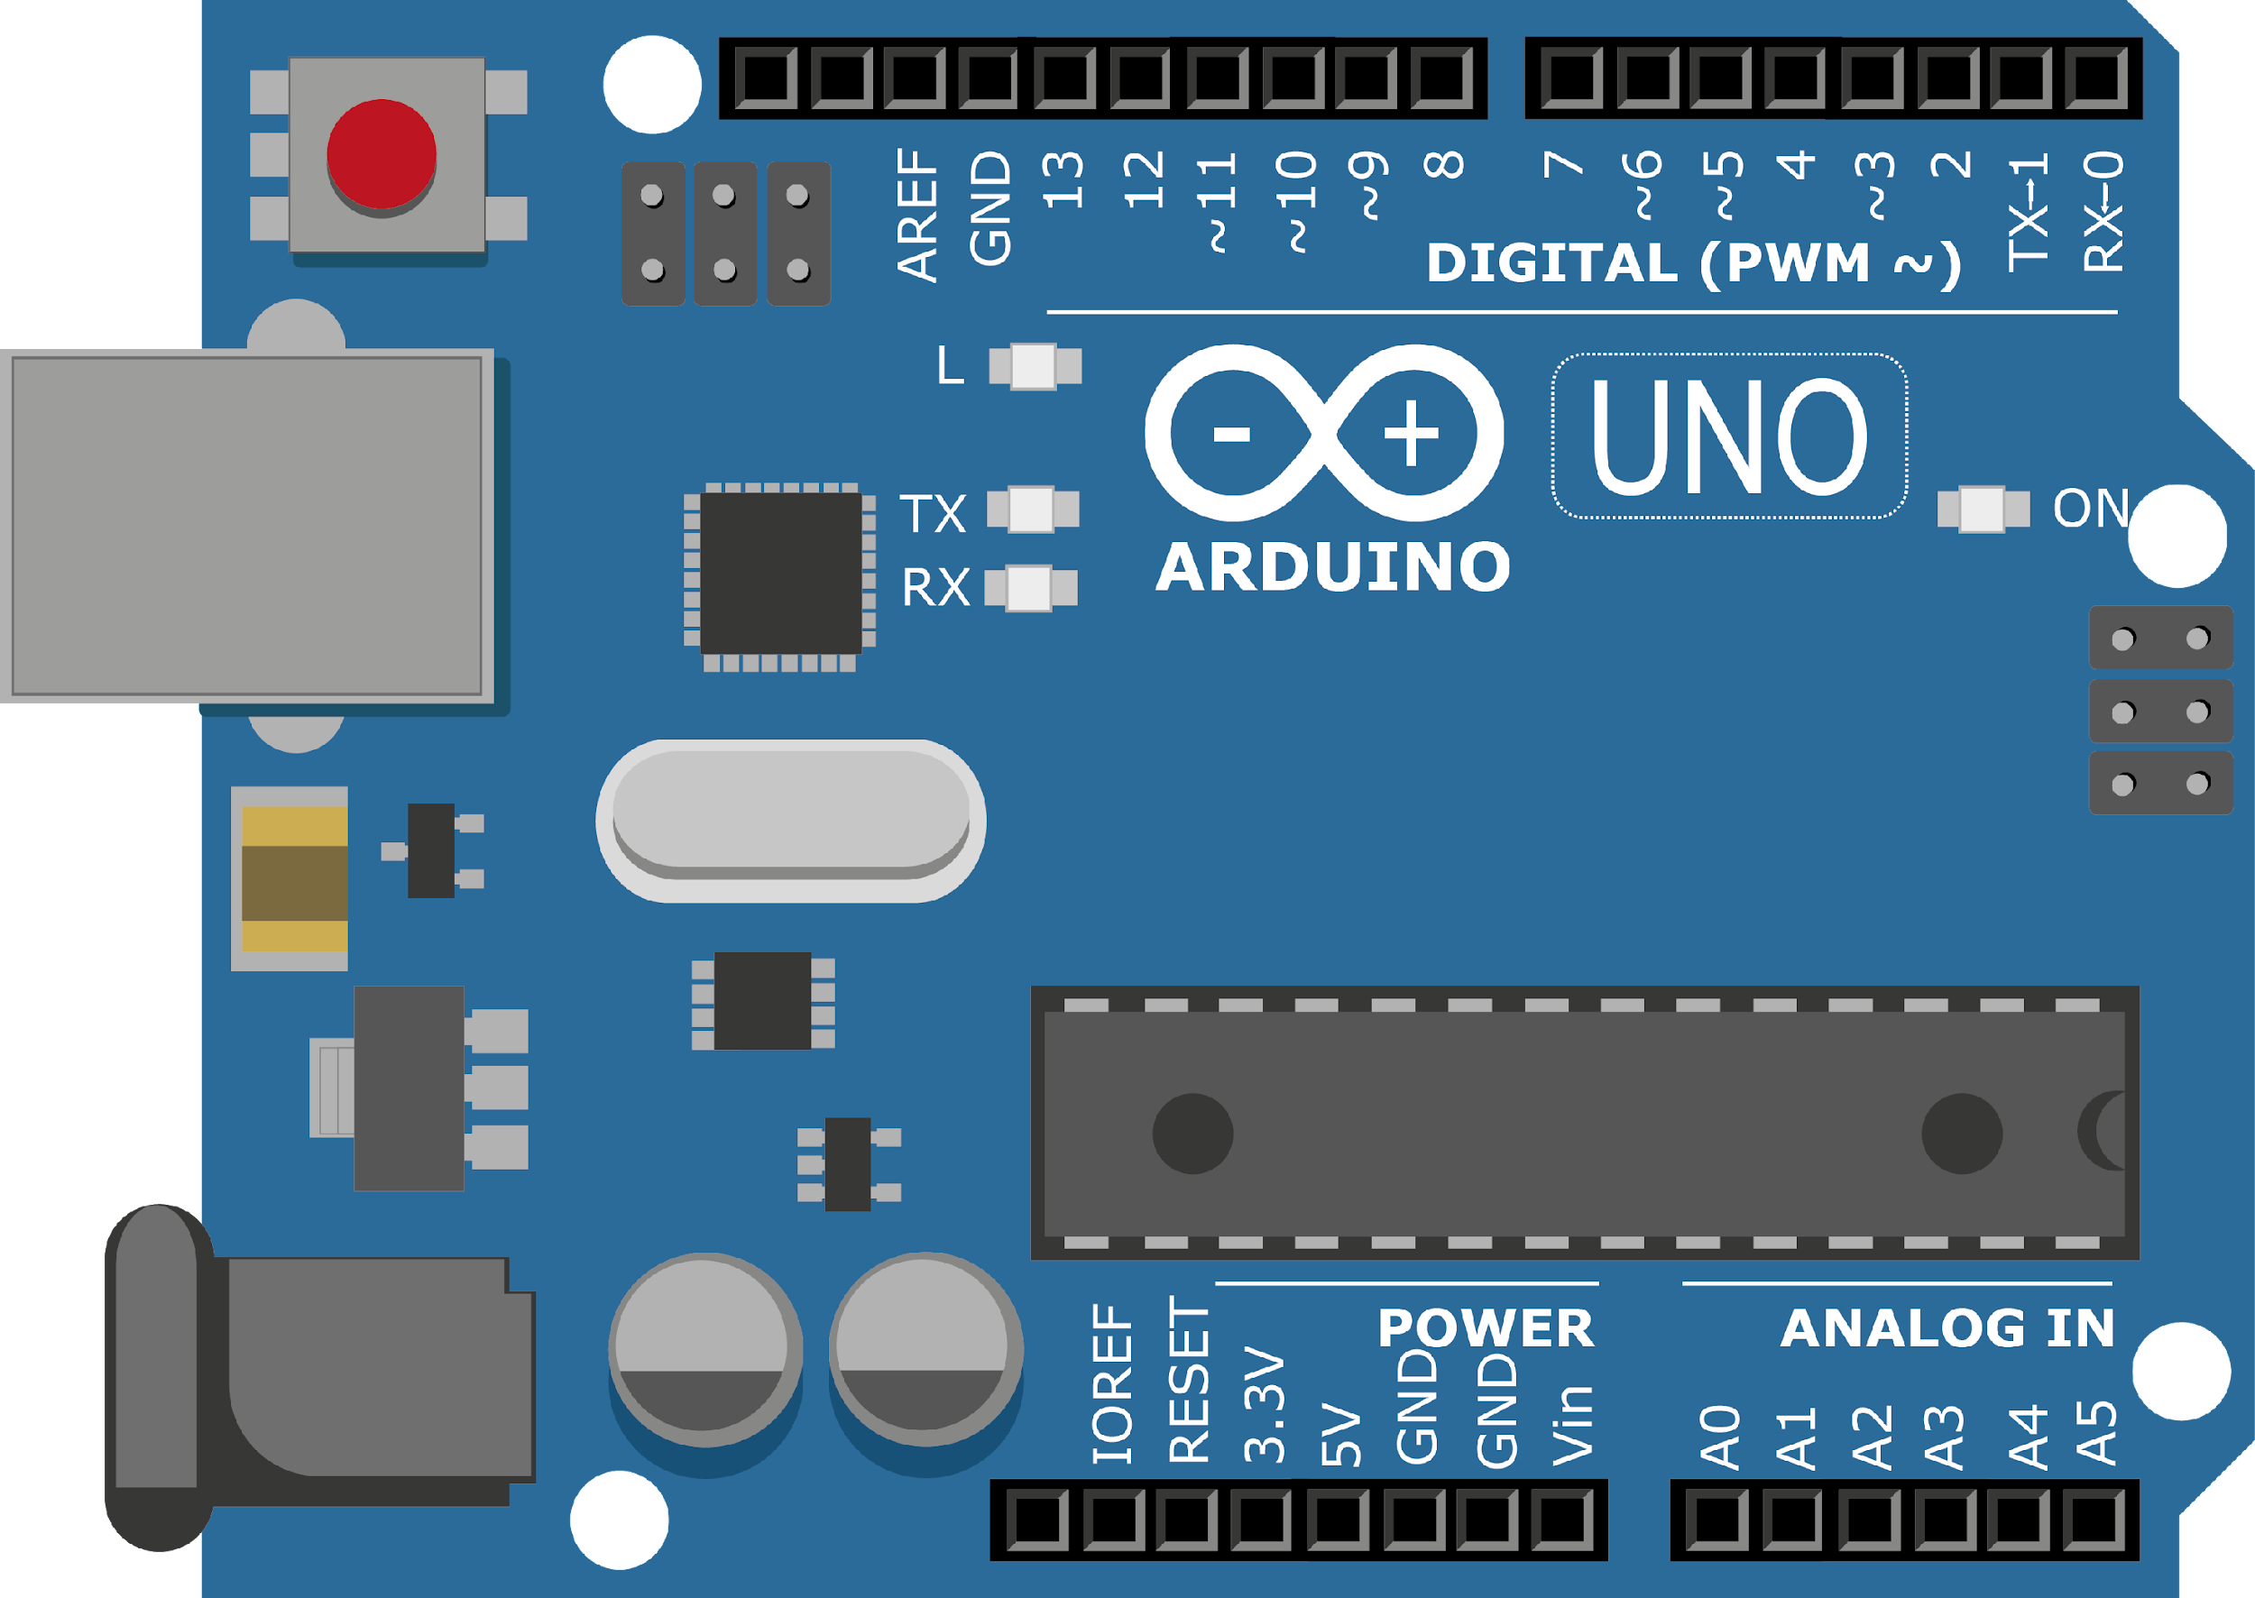
ARDUINO MASTER CLASS
07
RFID based authentication system | UART Protocol

Slide 2
7 AGENDA
02
03
01
Authentication system using RFReader
RF
Q & A

Slide 3
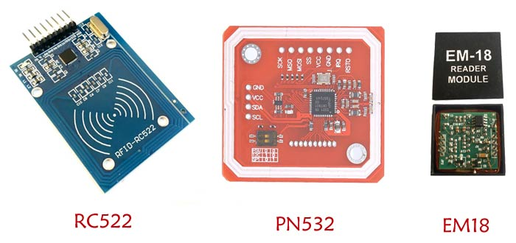
RFID - Radio Frequency Identification
The device is based on the Radio frequency signals.
The RFID systems consists of RFID Reader and a tag which is normally used in identification and tracking of objects.
It is a device which consists of an antenna, transceiver and a decoder.

Slide 4
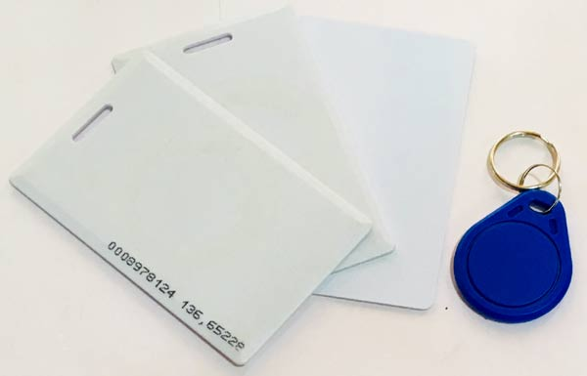
RFID - Radio Frequency Identification
Transceiver: It can be used either as a transmitter or a receiver. It consists of an oscillator to generate a continuous signal which is modulated to a required frequency and then transmitted into air through an antenna.
Antenna: It is a device which converts the electrical signal into electromagnetic signal which is efficient in propagating the signal in air.
Decoder: When a RF signal is detected at the antenna from a tag, the decoder helps in retrieving the data.

Slide 5
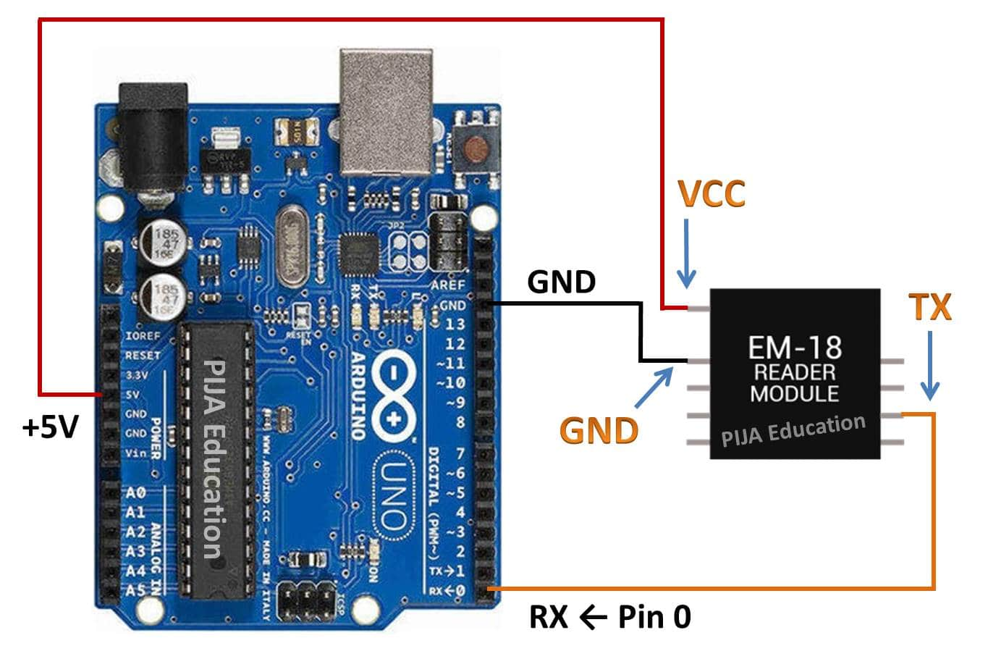
RFID with Arduino

Slide 6
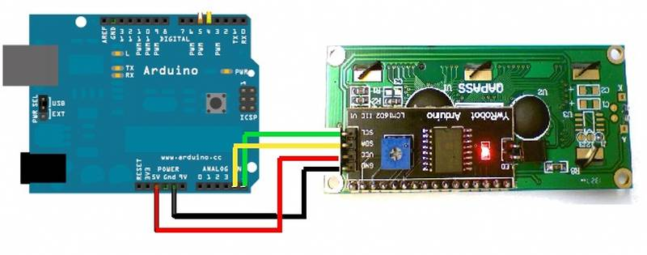
16x2 LCD with Arduino using I2C

Slide 7

INTERVIEW QUESTIONS
What is carrier to interference ratio(C/I)?
SNR
What is meant by RFID technology?
It uses radio waves to passively identify a tagged object.
All that is needed is radio communication between the tag and the reader.
C/I refer to ratio of carrier power to the interference power.
SNR refer to ratio of signal power to the noise power. C/I apply to modulated waveform while SNR applies to the unmodulated waveform

Slide 8

THANKS!

